Slide 1

DOM Introduction
Document Object Model
SoftUni Team
Technical Trainers
Software University
https://softuni.bg

Slide 2
Browser API
BOM
Browser Object Model (BOM)

Slide 3
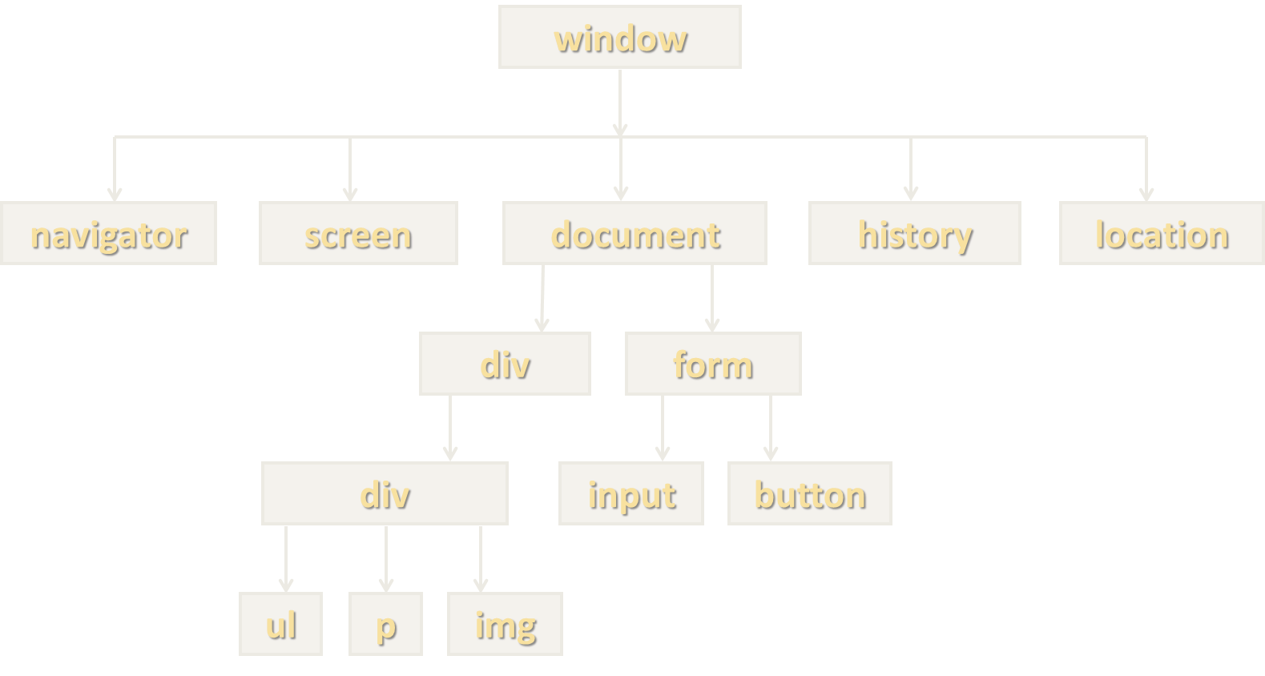
Browser Object Model (BOM)
Browsers expose some objects like window, screen, navigator, history, location, document, …
Most of this API will be examined in the next course
console.dir(window);
console.dir(navigator);
console.dir(screen);
console.dir(location);
console.dir(history);
console.dir(document);

Slide 4

Global Context in the Browser
The global object in the browser is window
let b = 8;
console.log(this.b); // undefined
var a = 5;
console.log(this.a); // 5
function foo() {
console.log("Simple function call");
console.log(this === window); // true
} foo();

Slide 5
Document Object Model (DOM)
Document with a Logical Tree

Slide 6

Document Object Model
The DOM represents the document as nodes and objects
That way, the programming languages can connect to the page
The HTML DOM is an Object Model for HTML. It defines:
HTML elements as objects
Properties
Methods
Events

Slide 7
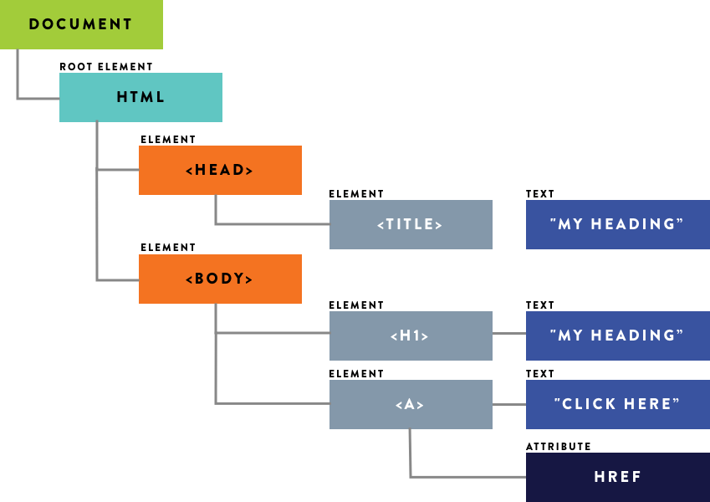
From HTML to DOM Tree
The browser parses HTML and creates a DOM Tree
The elements are nested in each other and create a hierarchy
Like the hierarchy of a street address – Country, City, Street, etc.
<html>
<head>
<title>My Heading</title>
</head>
<body>
<h1>My Heading</h1>
<a href="/about">Click Here</a>
</body>
</html>

Slide 8
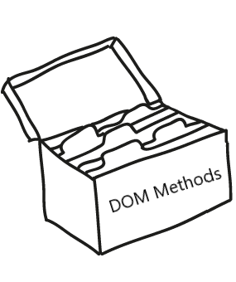
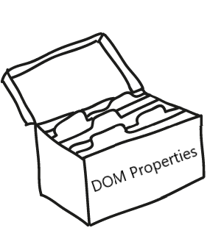
DOM Methods
DOM Methods - actions you can perform on HTML elements
DOM Properties - values of HTML elements that you can set or change

Slide 9
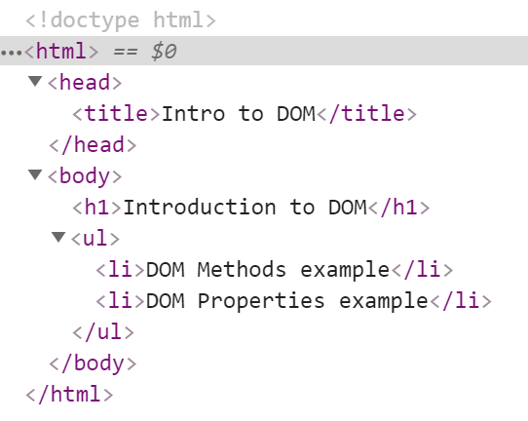



Example: DOM Methods
HTML DOM method is an action you can do (like add or delete an HTML element)

Slide 10
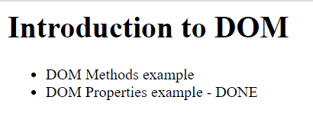
Example: DOM Methods
HTML DOM property is a value that you can get or set (changing the content of an HTML element)

Slide 11
Using the DOM API
JavaScript can interact with web pages via the DOM API:
Check the contents and structure of elements on the page
Modify element style and properties
Read user input and react to events
Create and remove elements
Most actions are performed when an event occurs
Events are "fired" when something of interest happens
All of this and more will be examined in upcoming lessons

Slide 12
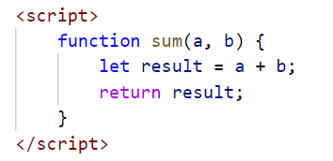
JavaScript in the Browser
Code can be executed in the page in different ways:
Directly in the developer console – when debugging
As a page event handler – e.g., user clicks on a button
Via inline script, using <script> tags
By importing from external file – most flexible method

Slide 13

HTML Elements
DOM Properties and HTML Attributes

Slide 14
Elements and Properties
The DOM Tree is comprised of HTML elements
Elements are JS objects with properties and methods
They can be accessed and modified like regular objects
To change the contents of the page:
Select an element to obtain a reference
Modify its properties

Slide 15
Attributes and Properties
Attributes are defined by HTML
Attributes initialize DOM properties
Property values can change via the DOM API
The HTML attribute and the DOM property are technically not the same thing
Since the outcome is the same, in practice you will almost never encounter a difference!

Slide 16

DOM Manipulations
The HTML DOM allows JavaScript to change the content of HTML elements
innerHTML
textContent
value
style
And many others to be discussed in upcoming lessons

Slide 17
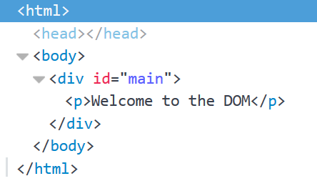
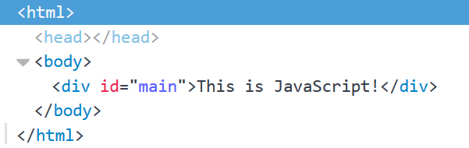
Accessing Element HTML
To access raw HTML:
This will be parsed – beware of XSS attacks!
Changing textContent or innerHTML removes all child nodes
element.innerHTML = "<p>Welcome to the DOM</p>";

Slide 18
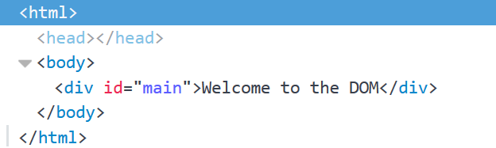
Accessing Element Text
The contents of HTML elements are stored in text nodes
To access the contents of an element:
If the element has children, returns all text concatenated
let text = element.textContent; //This is JavaScript!
element.textContent = "Welcome to the DOM";

Slide 19
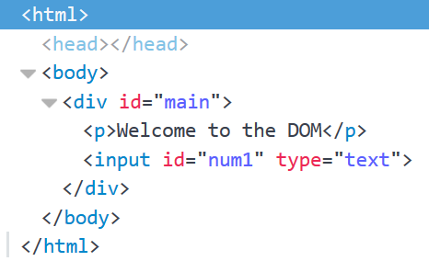
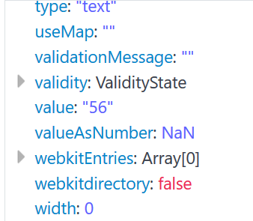
Accessing Element Values
The values of input elements are string properties on them:
let num = Number(element.value);
element.value = 56;

Slide 20
Targeting DOM Elements
Obtaining Element References

Slide 21
Targeting Elements
There are a few ways to find a certain HTML element in the DOM:
By ID - getElementById()
By class name - getElementsByClassName()
By tag name - getElementsByTagName()
By CSS selector - querySelector(), querySelectorAll()
These methods return a reference to the element, which can be manipulated with JavaScript

Slide 22
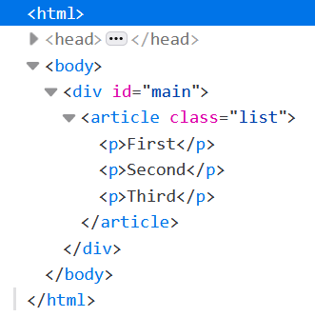
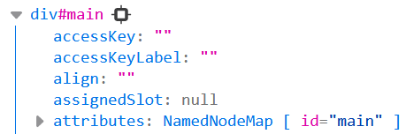
Targeting by ID - Example
The ID attribute must be unique on the page
const element = document.getElementById('main');
console.log(element);

Slide 23
Targeting by Tag and Class Names – Example
The tag name specifies the type of element – div, p, ul, etc.
Class names are used for styling and easier selection
Both methods return a live HTMLCollection
Even if only one element is selected! This is a common mistake
const elements = document.getElementsByTagName('p');
// Select all paragraphs on the page
const elements = document.getElementsByClassName('list');
// Select all elements having a class named 'list'

Slide 24
CSS Selectors
CSS selectors are strings that follow CSS syntax for matching
They allow very fast and powerful element matching, e.g.:
"#main" - returns the element with ID "main"
"#content div" - selects all <div>s inside #content
".note, .alert" - all elements with class "note" or "alert"
"input[name='login']" - <input> with name "login"

Slide 25
CSS Selectors - Example
Select the first matching element
Select all matching elements
Returns a static NodeList
const mainDiv = document.querySelector('#main');
// Select the element with ID 'main'
const element = document.querySelector('p');
// Select the first paragraph on the page
const elements = document.querySelectorAll('article.list');
// Select all <article> elements having a class named 'list'

Slide 26
NodeList vs. HTMLCollection
Both interfaces are collections of DOM nodes
NodeList can contain any node type, including text and whitespace
HTMLCollection contains only Element nodes
Both have iteration methods, HTMLCollection has an extra namedItem method
HTMLCollection is live, while NodeList can be either live or static

Slide 27
Iterating Element Collections
NodeList and HTMLCollection are NOT arrays but can be indexed and iterated
Both can be explicitly converted to an array
const elements = document.querySelectorAll('p');
const first = elements[0];
// Select the first paragraph on the page
for (let p of elements) { /* … */ }
// Iterate over all entries
const elementArray = Array.from(elements);
const elementArr2 = [...elements]; // Spread syntax

Slide 28
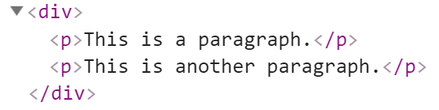

Parents and Child Elements
Every DOM Element has a parent
Parents can be accessed by property parentElement or parentNode
Accessing the first child
let firstP = document.getElementsByTagName('p')[0];
console.log(firstP.parentElement);
Accessing the child's parent

Slide 29
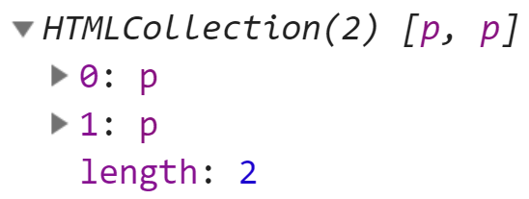
Parents and Child Elements
When some element contains other elements, that means he is parent of those elements
They are children to the parent. They can be accessed by property children
let pElements = document.getElementsByTagName('div')[0].children;
Returns live HTMLCollection

Slide 30

Using the DOM API
Common Techniques and Scenarios

Slide 31
External Page Scripts
Page scripts can be loaded from an external file
Use the src attribute of the script element
Functions from script files are in the global scope
Can be referenced and executed from events and inline scripts
Multiple script files in a page can see each other
Pay attention to load order!
<script src="app.js"></script>

Slide 32
Control Content via Visibility
Content can be hidden or revealed by changing its display style
This is a common technique to display content dynamically
To hide an element:
To reveal an element, set display to anything that isn't 'none' (including empty string)
const element = document.getElementById('main');
element.style.display = 'none';
element.style.display = ''; // Can be 'inline', 'block', etc.

Slide 33
Match n-th Child
Sometimes we need to target an element based on its relation to other similar elements
E.g., row or column in a table, list item, etc.
Can be done either by index or with a CSS selector
const list = document.getElementsByTagName('ul')[0];
// First <ul> on the page
const thirdLi = list.getElementsByTagName('li')[2];
// Third <li> inside the selected <ul>
const thirdLi = document.querySelector('ul li:nth-child(3)');
// Third <li> inside the first <ul> on the page

Slide 34

Live Demonstration
Lab Problems

Slide 35

Summary
BOM – Browser API
DOM
DOM is a programming API for HTML and XML documents
Selecting DOM elements
By Id
By Class Name
Query Selectors
DOM Properties & HTML Attributes
…
…
…

